Slide 1
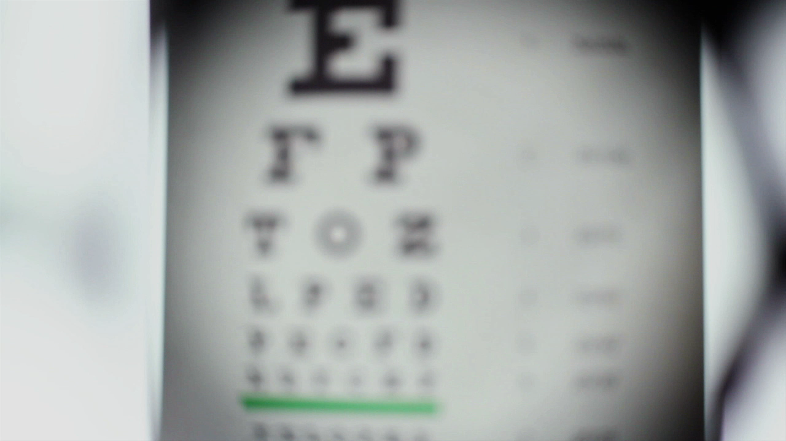
Fact Checking
Media Literacy introduction - lesson 3

Slide 2

When looking for information online what we are reading is often unedited and also it is not always clear who has actually written it.
How can we get beyond what is in front of us to check what is being said?

Slide 3
Spotting ‘Red Flags’
Even before checking the facts of a website or article the way the information is written and presented might be a red flag that it will not be a very trustworthy source of information.
What do you think these Red Flags might be?

Slide 4
1. Seeking an emotional reaction
If the article is written in a way that is clearly designed to provoke strong feelings in the reader like shock or disgust. This is designed to get the reader to react and share the article – known as ‘clickbait’
Try and find a good example of ‘clickbait’ now on your own device. Here are some more good examples
Here’s why we want to click on these dramatic headlines!

Slide 5
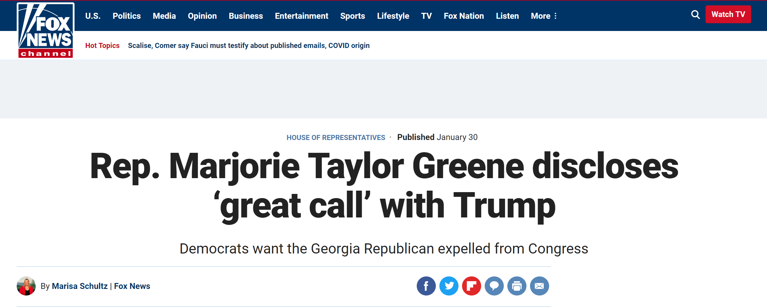
2. Confirmation bias
If an article is extremely one-sided or just too good to be true then it is likely that it is not a reliable source of information.
The human mind’s tendency to look for information that confirms what we already believe is very strong and is known as confirmation bias.

Slide 6
3. Uncredited work
If an article has no date or author so that its origins can be checked then that can often indicate that it is not a very reliable source of information.

Slide 7

So how do we fact check what we are reading online?

Slide 8
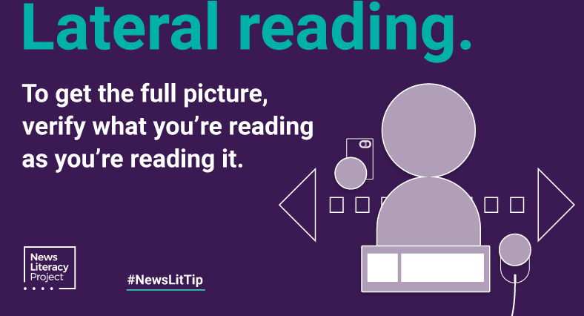
Lateral Reading
This is well explained in this excellent video by John Green from his Crash Course series.
Essentially it is vital that if you open up one website that you take the time to open up other websites to widen your investigation of a topic and to find information either to confirm or contradict what you first read.

Slide 9
‘Click Restraint’
Searching for a topic internet will not always take you to the most accurate and useful website, but most internet users will click only on the first two sites found when they make an internet search.
These top findings will be either adverts or the most popular sites for that search which does not necessarily make them accurate!
Take the time to look at more of the sites found in the search as they might be more helpful and accurate.

Slide 10
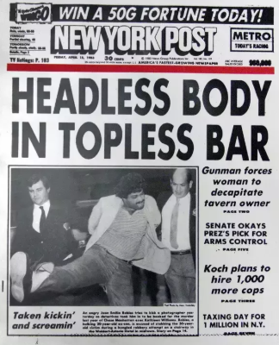
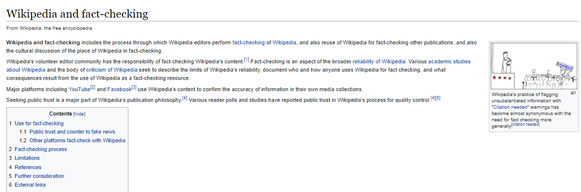
‘Reading Upstream’
Essentially this bit of fact-checking terminology is saying that you should read very article beyond its dramatic headline, and rather than take any bit of information that you read at face value you should always look to go further than the first bit of information you have been given and check where that has come from.
A good example of this is a Wikipedia article where often you can verify the information presented in the article by following the footnotes which tell you where that information came from.

Slide 11
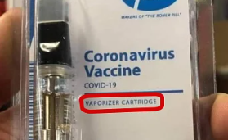
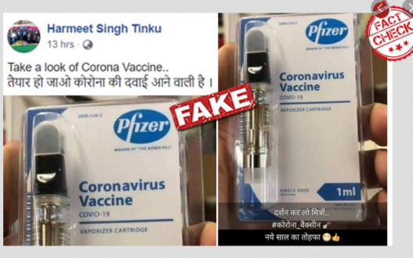
How to fact-check images
Internet technology now means that you can do a reverse image search for a picture to work out where they originated from and if they really are showing what they claim.
The picture on the right is from a twitter feed and looks very plausible.
But If you right click on it though and select
‘search google for image’ you find:
If using another web browser you will need to copy the picture to your desktop then you have the option to upload that image to images.google.com

Slide 12
There is help out there!
Here are just some of the fact checking organisations that exist and which can help to guide you through all the information that is out there!
Full Fact
Know News is an app that you can upload to your device and it automatically gives you a fact check of sites you visit
Snopes.com
Bellingcat
News Literacy Project
MediaWise

